Slide 1
Quadruped Robot for Agricultural Research
Team: Austin Neff, Kevin Nelson, Jordan Raver, Ben Siesser, Sam Spencer, Yang Yang
Team Advisors: Shad Roundy, Kam Leang

Slide 2
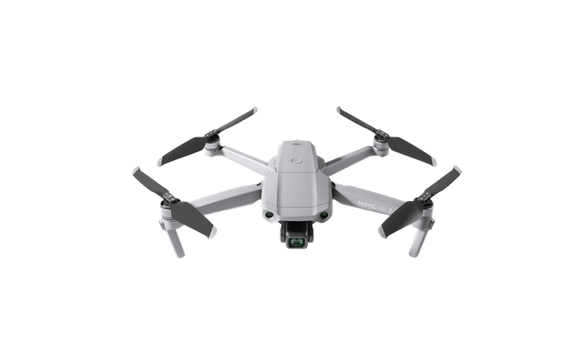
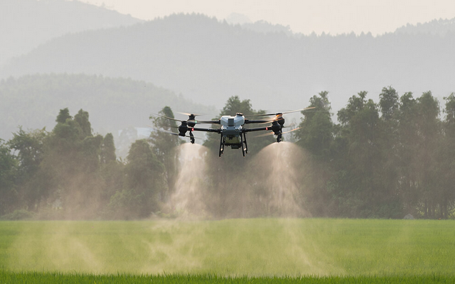
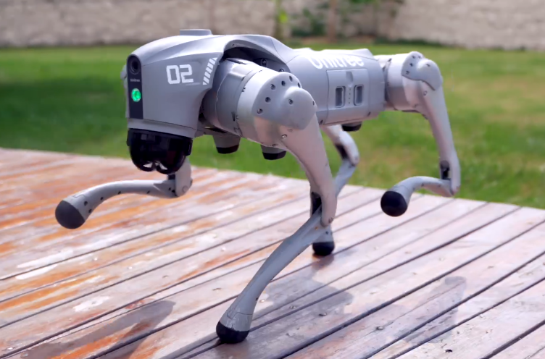
Project Background
In agriculture, autonomous quadcopters are the go-to solution for field surveying
However, they cannot land or modify the terrain, limiting their usefulness
An affordable quadruped could fill in these gaps
Notes:
In agriculture, autonomous quadcopters are the go-to solution for field surveying
However, these quadcopters are limited in what they can measure or modify due to their inability to land or dig
Consequently, a land vehicle is needed to fill in these gaps
Tracked vehicles cannot maneuver over and around sensitive crops without damaging them, so a quadruped is needed
Current quadruped options are some combination of expensive and locked down, so we need an alternative

Slide 3
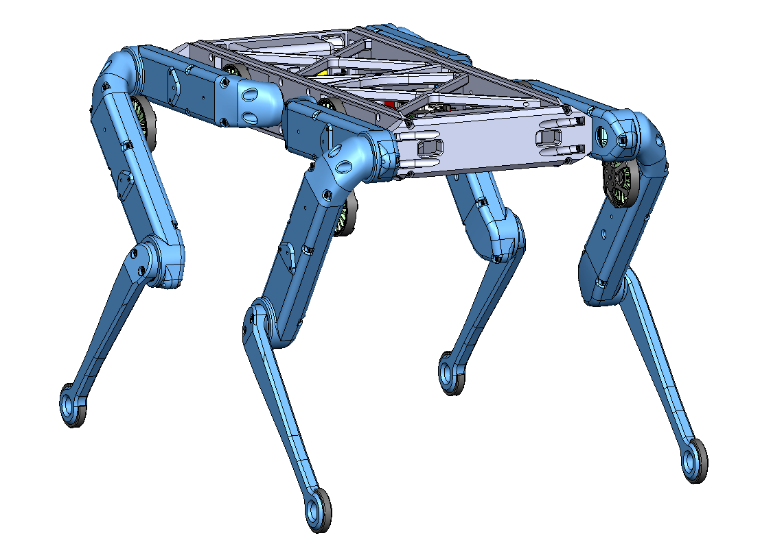
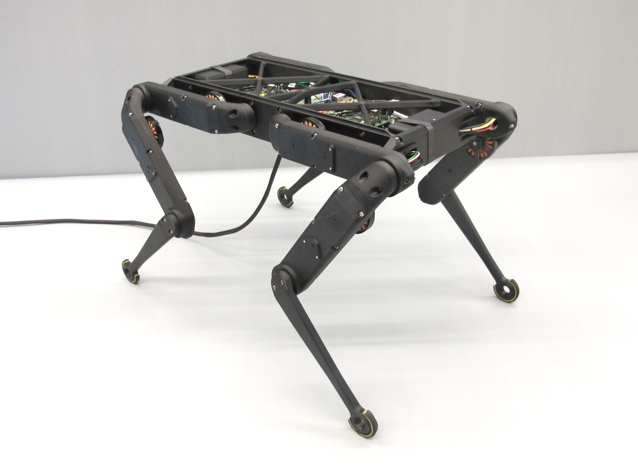
Project Objective
The objective of the project is to construct a quadruped robot. The Open Dynamic Robot Initiative will be used as guidance. The robot is intended as a cheaper and more open alternative for robot smart agriculture than what is currently available in professors Roundy and Leang’s laboratories.

Slide 4
Milestone Overview
Design Review One
Foundational code
Initial body assembly
First leg complete mounted
Midterm Review
All legs complete and mounted
Body enclosure complete
Basic quadruped motion
Design Review Two
Fully wireless control
Meets overall runtime expectations
Full walking capability
Basic navigation systems (optional)
Final Report
Advanced navigation algorithms (optional)
Bold = Completed

Slide 5
Milestones and Tasks Status
Number of design review 2 milestones met: 1/4
Number of design review 2 tasks met: 2/9
Number of ME EN 4010 milestones met: 6/11
Number of ME EN 4010 tasks met: 22/35

Slide 6
Milestone 7 - Wireless Control
Milestone
Fully autonomous; no tether. Robot is able to run off of battery power and be controlled via a SSH network
Metric of Success
No physical connections necessary to direct and move
Result
Metric achieved
All robot control and commands carried out wirelessly
Future
None

Slide 7
Milestone 8 - Runtime
Milestone
On-board Power System can run for minimum 30 minutes
Metric of Success
Runtime in general walking scenario >30 minutes
Result
Max draw 15 Amps
~40 mins of run time at max draw
Future
Run a full duration test until battery drained

Slide 8
Milestone 9 - Walking
Milestone
Full motion of robot, able to walk distances consistently without issues in varied environments including outdoor areas
Metric of Success
Variable speed, rough terrain capability
Result
Not yet complete
Standing/sitting sequence is functional
Future
Refine walking primitives
Test primitives
Include advanced functionality

Slide 9
Milestone 4 - Basic Navigation (Optional)
Milestone
Basic Navigation to beacons using GPS or towards a radio frequency
Metric of Success
Can navigate to beacons with wireless (radio) detection. Basic navigation entails a simple depth first search algorithm to move across discretized field locations until signal peaks for goal
Result
Not complete
Future
This likely will not be completed, and our advisors are aware

Slide 10
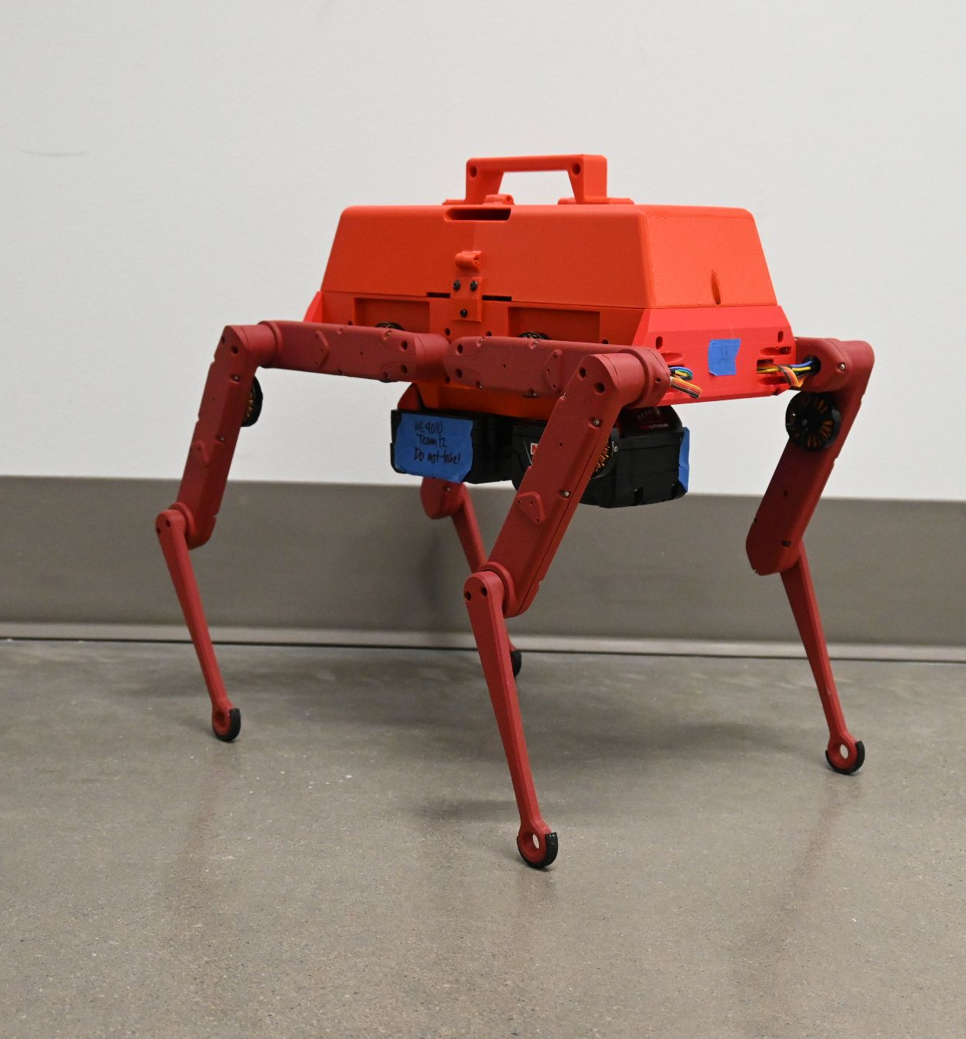
Mandatory Tasks to Do
Future Tasks
Run an endurance test, log results
Test additional battery sizes if results are disagreeable
Add IMU modification to target joint angles
Create additional primitives for faster or slower gaits

Slide 11
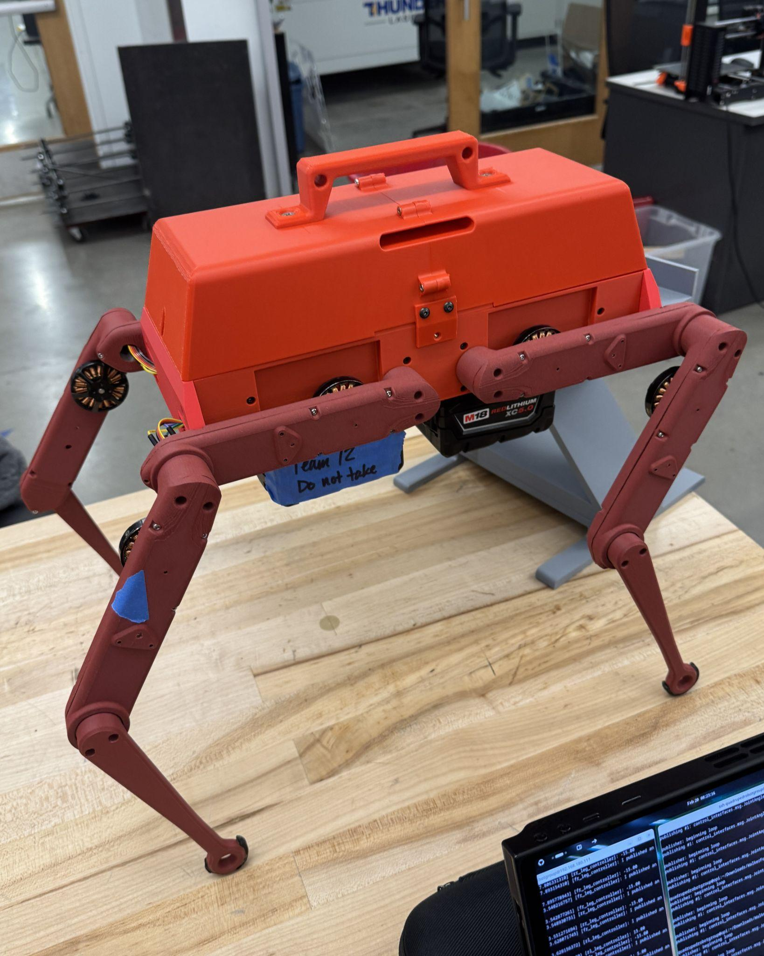
Optional Tasks to Do
Future Tasks
Implement necessary additional navigation sensors
Write a simple seeker node
Implement advanced navigation algorithm
Expand seeker node to accept multiple targets
Redesign cover to accommodate 80mm fan

Slide 12
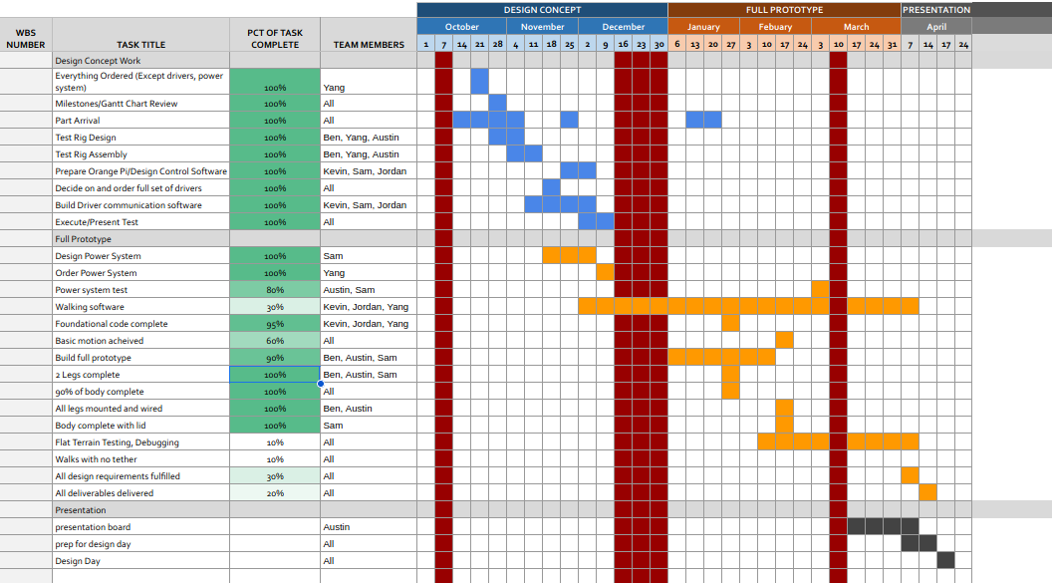
Project Management - Plans

Slide 13
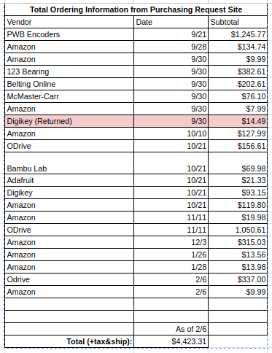
Budget Update
Total Spent: $4423.31
Total Budget Available: $6000
Remaining: $1576.69
Projected Usage:
$200 for backup parts

Slide 14
Team Member Contributions
Austin
Worked on presentation and assignment making
Helped with assembly
Will lead poster design
Ben
Led leg assembly
Led 3D printing
Sam
Led body design
Led mounting hardware
Batteries
Kevin
Led the leg control code and inverse kinematic implementation
Set up wireless control of robot
Jordan
Communication with advisors
Worked on leg control code and inverse kinematic
Yang
Led part ordering & maintaining BOM
Worked on IMU control code

Slide 15
Questions?

